Slide 1
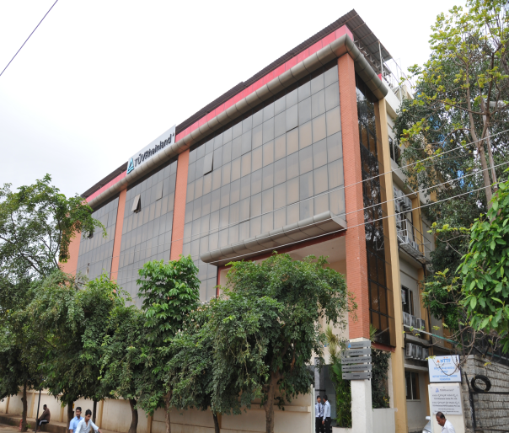
Introduction TR India
Established : 1996
Headquarters : Bangalore
No of Employees : 484
Turnover : 13 Million Euros
Presence : 25+ Cities
Subsidiary : TR NIFE Academy Pvt Ltd
No of Employees : 400 +
Turnver : 4 million Euros
Presence : 80 + Cities

Slide 2
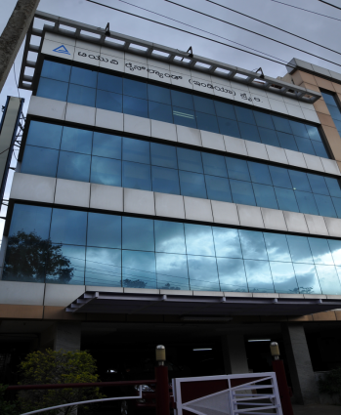
Index
Introduction of Compliance in India
TR India - Compliance Manuals
Steps taken / initiated towards Compliance till date
Challenges faced
E-Learning & Compliance Education
Monitoring on Compliance Issues
Work Instructions
Photovoltaic & Material Testing Lab

Slide 3
EMC Laboratory – Phase I, Electronics City, Bangalore

Slide 4
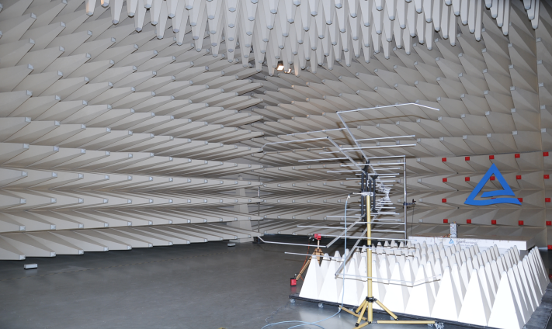
EMC Laboratory – Phase I, Electronics City, Bangalore

Slide 5
Introduction of Compliance in India
Compliance related activities were initiated at TR India in the year 2004, when the first version of the Employee Hand Book and The Code of Conduct was released.
The second version was revised in 2007 and later updated in 2011 and has since been uploaded in TR India intranet (Blueye).
The Hand Book and The Code of Conduct define the acceptable norms at TR India related to the following:
Ethical Conduct - Prevention of Bribery, Accepting Favors, Entertainment & Conflict Management
Employment Terms & Practices - Working Hours, Harassments, Obligations, Behavior, Dress Code etc.
Occupational Health & Safety
Relationship Management - Staff, Customers, Vendors
Integrity, Anti-Corruption & Corporate Social, Economical & Ecological Responsibility
Penal Provisions

Slide 6
TR India Compliance Manuals
Employee handbook:
Is a manual given to the new employees which contains information about the company policies and procedures
Code of Conduct:
Code of conduct is a elaboration of TÜV Rheinland India principles of conduct and actions to be followed by all the employees
Disciplinary Procedure:
It means voluntary and willing compliance of rules and regulations and instructions and also development of right habits of conduct in work with others at the work-place
Grievance Procedure:
TUV Rheinland India believes in maintaining cordial and harmonious relations with its employees. It strives to work in complete understanding with its employees and resolve differences if any, through mutual discussions and negotiations
Sexual Harassment Redressal Procedure:
The purpose of this procedure is to prevent or deter the commission of acts of sexual harassment inside the company premises

Slide 7
Steps towards adherence to Compliance
Continue with revisions of all Compliance manuals at periodic intervals.
Work Instructions/ Procedures
Incorporation of Confidentiality Clause in The Code of Conduct .
Management Declarations by all managers.
Signing of Non-Disclosure Agreement (NDA) with our customers & employees.
Conducting awareness session on Compliance during induction of new employees.
Compliance e-Learning Programs
Ethical misconduct reported & appropriate Penal actions taken / initiated with Zero tolerance in view.
Inclusion of a female Advocate in the Sexual Harassment Redressal Committee, being an expert in the above domain.
Introduction of Compliance Hotline Nos.

Slide 8
e-Learning & Compliance Education
The company provides employees with opportunities upgrade their job skills and knowledge by offering various courses through Blueye. E-Learning programs on Compliance are also a part of such offerings.
Employees are also provided a refresher course on Compliance, once in every six months, through a series of Presentations for a nine day span.

Slide 9
Monitoring Tools for enforcing Compliance
Integrity Declarations
An Integrity Declaration shall be sent to the target factories/entities to seek their cooperation to comply with our corporate guidelines
Telephone Audits
Compliance Officer or his nominee conducts Telephone Audits with clients/ customers, to ensure that the company auditors and/ or inspectors act in conformity with our principles and do not demand any personal favors.

Slide 10
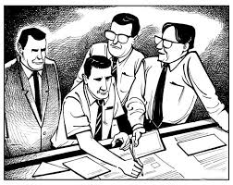
Monitoring Tools for enforcing Compliance (contd..)
Mystery Audits :
Compliance Officer/his nominee conducts mystery audits which are unknown to the targets. They accompany the auditors / inspectors ( unannounced) to the client’s location with their true identity hidden .
On-site Integrity Audits (Factory Visits)
Compliance Officers visit the target factories / entities for which the Auditors / Inspectors of the TUVR have already conducted audits / inspections, in order to cross-check the integrity performance of these Auditors / Inspectors. The visits will not be revealed to the concerned Auditors / Inspectors.

Slide 11
Procedure for Compliance Investigation
Following Document lays out all the procedural steps for carrying out any Compliance related Investigation in TR- India.

Slide 12
Need for Compliance Management
India is a growing economy which is a good sign for us too at TUV Rheinland .
We are now an accredited lab for Bureau of Indian Standards ( BIS),
we have various accreditations with NABCB, NABL, BIS, etc which makes it all the more
Important for us to maintain our integrity.
Our Steering Committee for BS – Systems was also keen on our monitoring mechanism
We also work with a lot of external partners and it makes us more cautious and
responsible.
Present Status : We have got the buy in from all BS Managers to roll it out for all BS
across India.

Slide 13
Challenges faced
Lengthy legal processes involved.
Pro-employee approach by the Judicial system.
Affiliation of worker’s unions to different Political parties. ( not directly affecting us).
Persuading multinational Corporations to adhere to the Laws of India while signing NDAs.

Slide 14
Thank you

